Slide 1
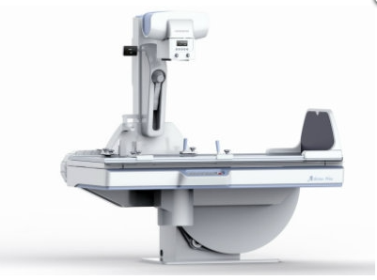
Digital Fluoroscopy

Slide 2
Digital fluoroscopy (DF) is a digital x-ray imaging system that produces dynamic images obtained with an area x-ray beam. The difference between conventional fluoroscopy and DF is the nature of the image and the manner in which it is digitized.
The early approach was to use fluoroscopic equipment while placing a computer between the television camera tube and the television monitor. The video signal from the television camera tube was routed through the computer, manipulated in various ways, and transmitted to a television monitor in a form ready for viewing.

Slide 3
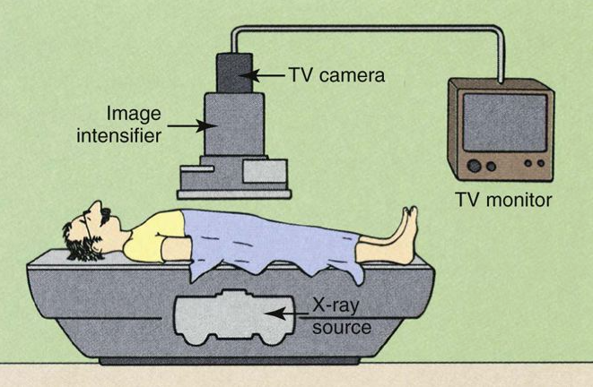
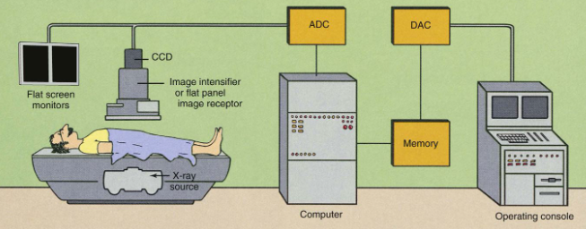
Advantages of DF over conventional fluoroscopy include the speed of image acquisition and postprocessing to enhance image contras

Slide 4
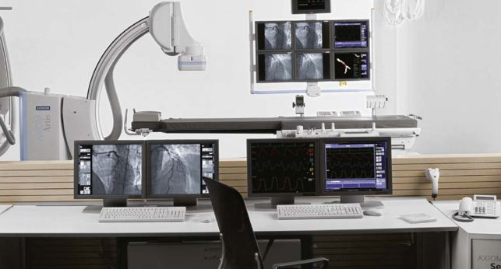

Slide 5
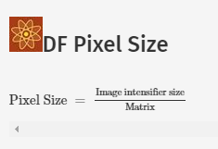
A 1024 × 1024 image matrix sometimes is described as a 1000-line system. In DF, the spatial resolution is determined both by the image matrix and by the size of the image intensifier. Spatial resolution is limited by pixel size.

Slide 6
A DF examination is conducted in much the same manner as a conventional fluoroscopic study. To the casual observer, the equipment is the same, but such is not the case. A computer has been added, as have multiple monitors and a more complex operating console
During DF, the under-table x-ray tube actually operates in the radiographic mode. Tube current is measured in hundreds of mA instead of less than 5 mA, as in image-intensifying fluoroscopy.
This is not a problem, however. If the tube were energized continuously, it would fail because of thermal overloading, and the patient radiation dose would be exceedingly high. Images from DF are obtained by pulsing the x-ray beam in a manner called pulse-progressive fluoroscopy.

Slide 7
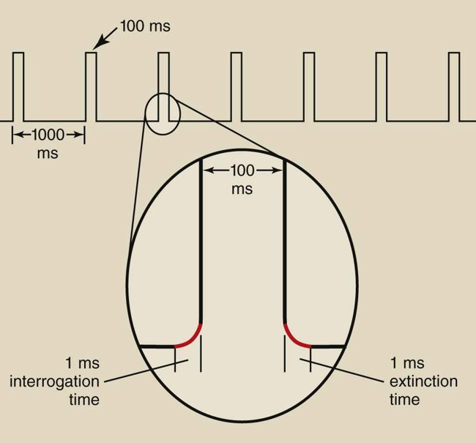
The x-ray generator must be capable of switching on and off very rapidly. The time required for the x-ray tube to be switched on and reach selected levels of kilovolt peak (kVp) and mA is called the interrogation time. The time required for the x-ray tube to be switched off is the extinction time. DF systems must incorporate high-frequency generators with interrogation and extinction times of less than 1 ms.
Pulse progressive fluoroscopy is essential for reducing patient radiation dose and should be routinely used.

Slide 8
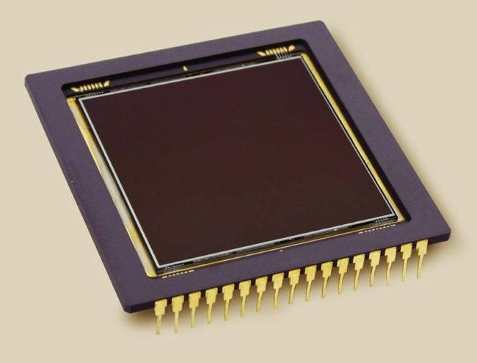
A major change from conventional fluoroscopy to DF is the use of a charge-coupled device (CCD) instead of a TV camera tube. The CCD was developed in the 1970s for military applications, especially in night vision scopes. Today, CCDs are used in the digital camera, commercial television, security surveillance, and astronomy
The sensitive component of a CCD is a layer of crystalline silicon. When this silicon is illuminated, electrical charge is generated, which is then sampled, pixel by pixel, and manipulated to produce a digital image

Slide 9
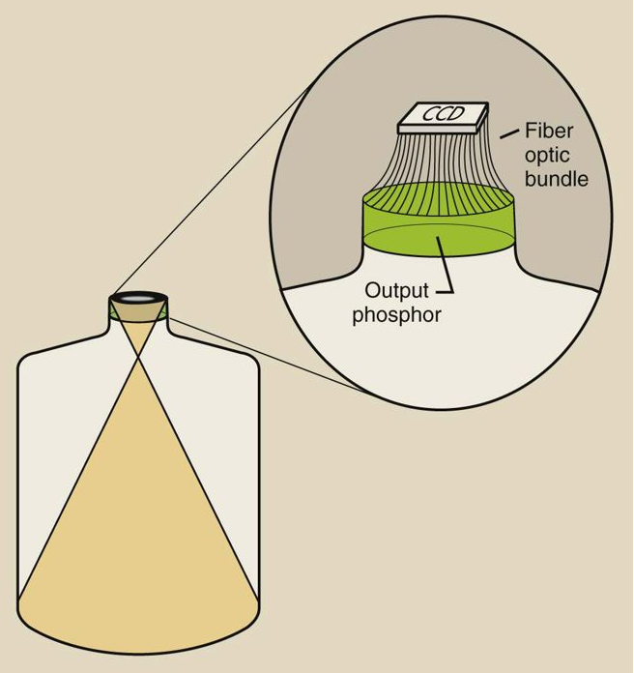

Slide 10
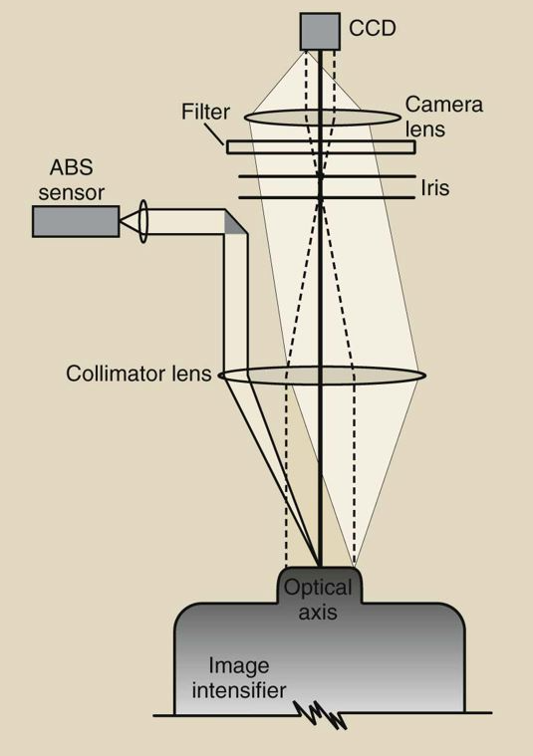
An example of a lens-coupling system for a charge-coupled device (CCD) to an image intensifie

Slide 11
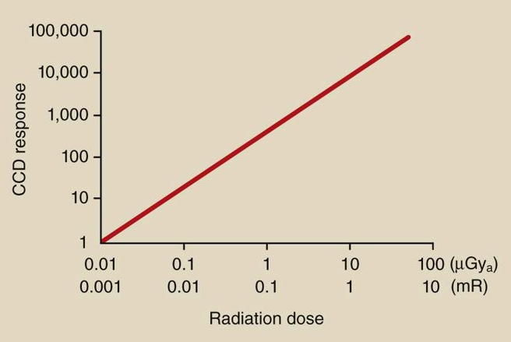

Slide 12
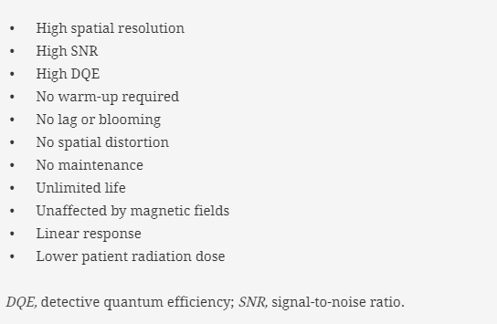
Advantages of CCD
DF with CCD results in wider dynamic range and better contrast resolution than conventional fluoroscopy.

Slide 13
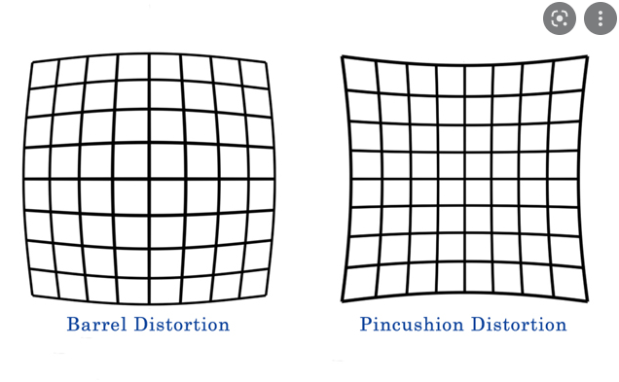
The CCD is mounted on the output phosphor of the image-intensifier tube and is coupled through fiberoptics or a lens system.
The spatial resolution of a CCD is determined by its physical size and pixel count. Systems that incorporate a 1024 matrix can produce images with 10 lp/mm spatial resolution. Television camera tubes can show spatial distortion in what is described as “pin cushion” or “barrel” artifact. No such distortion occurs with a CCD.

Slide 14
The CCD has greater sensitivity to light (detective quantum efficiency) and a lower level of electronic noise than a television camera tube. The results are a higher signal-to-noise ratio (SNR) and better contrast resolution. These characteristics also result in substantially lower patient radiation doses.
The response of the CCD to light is very stable. Warm-up of the CCD is not required. Neither image lag nor blooming is present. It has essentially an unlimited lifetime and requires no maintenance

Slide 15
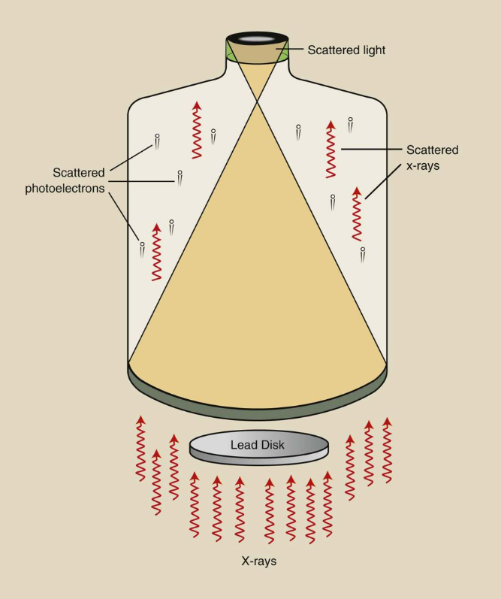
Veiling glare reduces the contrast of an image-intensifier tube

Slide 16
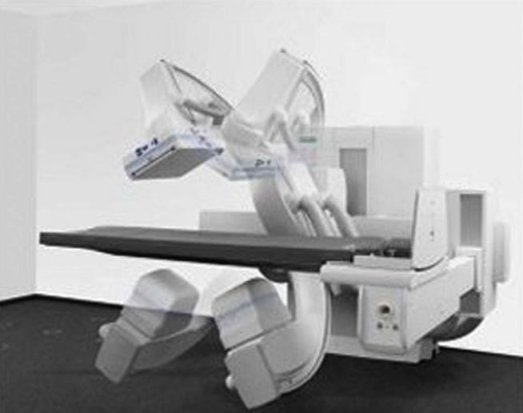
The further improvement of DF imaging is developing the flat panel image receptor (FPIR). Such an image receptor is composed of cesium iodide (CsI)/amorphous silicon (a-Si) pixels.

Slide 17
Advantages of Flat Panel Image Receptors Over Charge-Coupled Device Image Intensifiers in Digital Fluoroscopy
• Distortion-free images
• Constant image quality over the entire image
• Improved contrast resolution over the entire image
• High DQE (see Chapter 16) at all radiation dose levels
• Rectangular image area coupled to similar image monitor
• Unaffected by external magnetic field

Slide 18
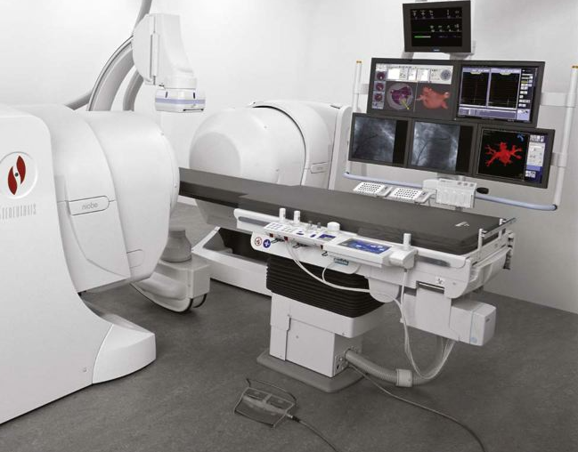
The image intensifier is limited by nonuniform spatial resolution and contrast resolution from the center to the periphery of the circular image. Veiling glare and pincushion distortion increase with age on an image intensifier. The response of an FPIR is uniform over the entire receptor and does not degrade with age.
A special catheter with a magnetic tip is introduced into the patient vasculature. This catheter is manipulated remotely through tortuous vessels by two large steering magnets that are located on either side of the patient. This technology will find advanced application in cardiology and in neurovascular radiology.

Slide 19
The principal advantages of DF examinations are the image subtraction techniques that are possible and the enhanced visualization of vasculature that results from venous injection of contrast material. Unfortunately, an area beam must be used, which reduces image contrast because of associated Compton scatter radiation.
Image contrast, however, can be enhanced electronically. Image contrast is improved by subtraction techniques that provide instantaneous viewing of the subtracted image during passage of a bolus of contrast medium

